Slide 1
Day 2. Session 1 R-packages, functions and basic operations

Slide 2
Functions
These are for manipulating objects.
Functions can be as simple as a sum() and as complex as a sophisticated statistical model lm()

Slide 3
But these are written the same:
mean(x, na.rm=TRUE)
Function name
Arguments always within brackets
Take the mean of a vector x
Remove missing values and compute the mean anyway

Slide 4
Nested functions:
Detect missing values in x:
X<- c(23,28,49,NA,34)
is.na(x)
Nested functions: I can detect the missing values and also take the sum to count them.
sum(is.na(x))

Slide 5
Nested functions
I can also create an object that stores the missing values
Missx<-sum(is.na(x))

Slide 6
R packages: Super functions

Slide 7
R-packages
R, by default, has a reduced number of functions: You customise R depending on your needs
The most useful, powerful and modern functions come in R-packages (Things that the R community develops)
Very ofetn you need an R-package to do the most interesting analyses and more powerful procedures

Slide 8
How can I get a package?
Let’s say you want to import data that was stored in Stata
Well, there is an R-package that does that is called: haven
To install a Rpackage you need a function and internet:
install.packages(“haven”)

Slide 9
That’s it?
Well to save memory R does not load all the functions you have installed.
You will have to call the package whenever you need it with the function “library”:
library(haven)

Slide 10
Packages have functions
To import from stata
read_dta(“nameofdata.dta”)
To import from spss
read_spss(“nameofdata.dta”)
We will see that other packages are useful to excel files

Slide 11
Let’s install some packages
install.packages(“haven”)
install.packages(“descr”)
install.packages(“data.table”)

Slide 12
Let’s load some packages
library(haven)
library(dplyr)
library(data.table)

Slide 13

R universes: Super packages

Slide 14
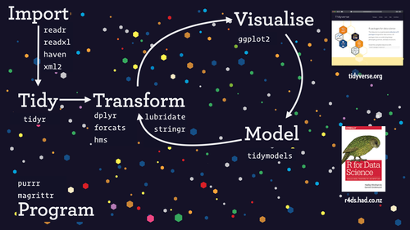
Tidyverse
Suite of Rpackages for powerful data management in R
haven # Exporting/Importing data in different formats
ggplot # Pretty plots using graphical language
dplyr # Efficient data manipulations (recoding, filtering, subseting) using pipeline writing
tidyr # Advanced transformations like rotation (wide to long, long to wide)

Slide 15

Officeverse & officedown
Generating word and Microsoft documents within R with Rmarkdown
flextable #tables
officer #translation to office using pandoc
Officedown

Slide 16
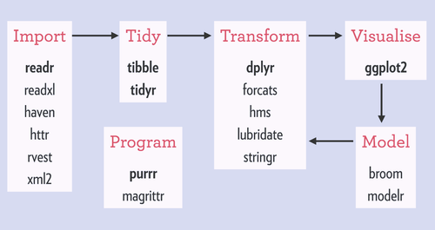

Slide 17
Packages for data management and cleaning
install.packages(“dplyr”)
install.packages(“tidyr”)
install.packages(“stringr”)
install.pacakges(“janitor”)

Slide 18
Packages for descriptives
install.packages(“descr”)
install.packages(“expss”)
install.packages(“skimr”)

Slide 19
Survey data
Install.packages(“survey”)
# We will be using on monday this one

Slide 20
Excercise
Install the rest of the packages listed in the powerpoint please

Slide 21
Pipeline instructions in R

Slide 22
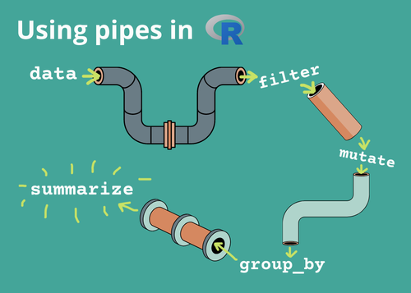
New way of coding in R %>%

Slide 23
%>% (Pipeline operator)
Prior versions in R:
mean(D[D$gender == "F", "age"])
Take the mean of age in the D dataset when gender is equal to “F”
Newer syntax
library(dplyr)
D %>%
filter(gender == "F") %>%
summarise(mean_age = mean(age, na.rm = TRUE))

Slide 24
Subseting data or variables
D[, c("id", "gender", "color")]
library(dplyr)
D %>%
select(id, gender, color)

Slide 25
Aggregating data
aggregate(age ~ gender, data = D, FUN = mean)
library(dplyr)
D %>%
group_by(gender) %>%
summarise(mean_age = mean(age, na.rm = TRUE))

